Slide 1
Support Vector Machine

Slide 2
Support Vector Machine
Support vector machines (SVMs) are a set of supervised learning methods used for classification and regression.
Though we say regression problems as well its best suited for classification.
The goal of the SVM algorithm is to create the best line or decision boundary that can segregate n-dimensional space into classes so that we can easily put the new data point in the correct category in the future. This best decision boundary is called a hyperplane.
SVM chooses the extreme points/vectors that help in creating the hyperplane. These extreme cases are called as support vectors.

Slide 3
Support Vector Machine
SVMs is useful because they can find complex relationships between your data without you needing to do a lot of transformations on your own. It's a great option when you are working with smaller datasets that have tens to hundreds of thousands of features. They typically find more accurate results when compared to other algorithms because of their ability to handle small, complex datasets.
SVMs are used in applications like handwriting recognition, intrusion detection, face detection, email classification, and in web pages.

Slide 4
How an SVM works
A simple linear SVM classifier works by making a straight line between two classes.
That means all of the data points on one side of the line will represent a category and the data points on the other side of the line will be put into a different category.
This means there can be an infinite number of lines to choose from.
The specialty of SVM is that it chooses the best line to classify your data points. It chooses the line that separates the data and is the furthest away from the closet data points as possible.

Slide 5


Slide 6
Hyperplane
There can be multiple lines/decision boundaries to segregate the classes in n-dimensional space, but we need to find out the best decision boundary that helps to classify the data points.
Hyperplanes are decision boundaries that help classify the data points. Data points falling on either side of the hyperplane can be attributed to different classes.
This best boundary is known as the hyperplane of SVM.

Slide 7
Hyperplane
The dimensions of the hyperplane depend on the features present in the dataset, which means if there are 2 features, then hyperplane will be a straight line.
And if there are 3 features, then hyperplane will be a 2-dimension plane.
We always create a hyperplane that has a maximum margin, which means the maximum distance between the data points.
Reason for selecting the hyper-plane with higher margin is robustness. If we select a hyper-plane having low margin then there is high chance of miss-classification.

Slide 8
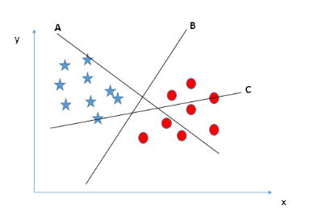
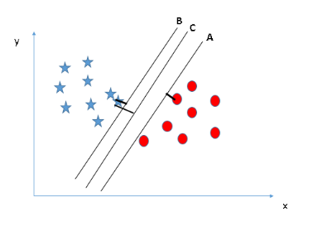
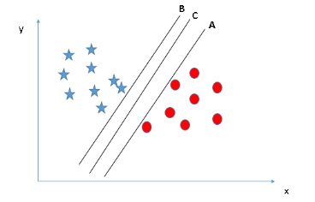

Slide 9
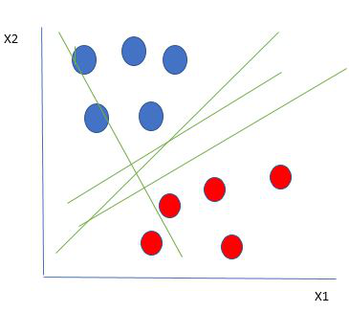
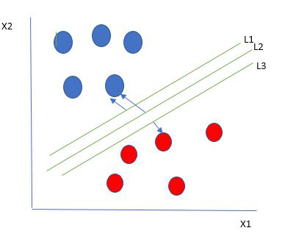
There are multiple lines that segregates our data points or does a classification between red and blue circles.
So how do we choose the best line or in general the best hyperplane that segregates our data points.
We choose the hyperplane whose distance from it to the nearest data point on each side is maximized. If such a hyperplane exists it is known as the maximum-margin hyperplane/hard margin.
From the figure, we choose L2.

Slide 10
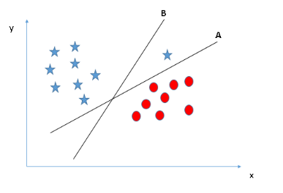
Variations in Hyperplane

Slide 11
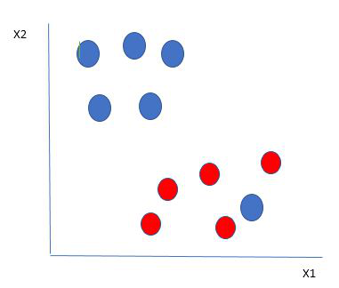
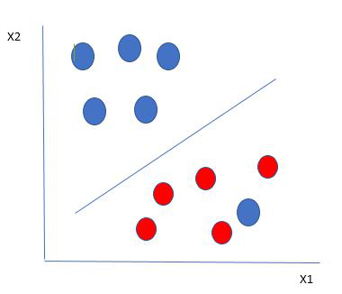
Variations in Hyperplane

Slide 12
Support Vectors
The data points or vectors that are the closest to the hyperplane and which affect the position of the hyperplane are termed as Support Vector.
Since these vectors support the hyperplane, hence called a Support vector.
Using these support vectors, we maximize the margin of the classifier. Deleting the support vectors will change the position of the hyperplane. These are the points that help us build our SVM.

Slide 13
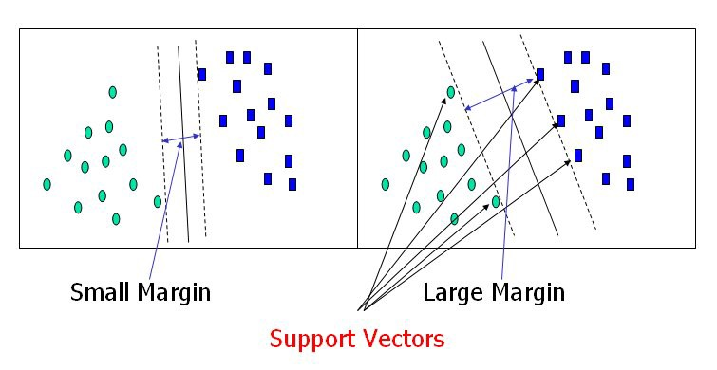

Slide 14
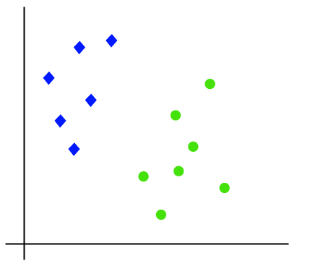
Types of SVM
Linear SVM: Linear SVM is used for linearly separable data, which means if a dataset can be classified into two classes by using a single straight line, then such data is termed as linearly separable data, and classifier is used called as Linear SVM classifier.

Slide 15
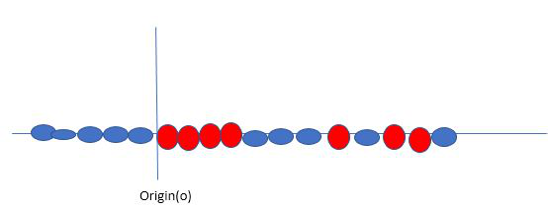

Slide 16
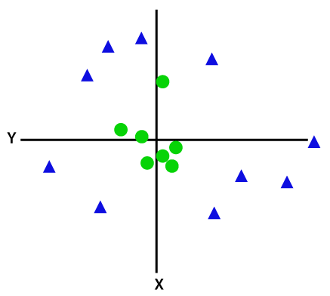
Types of SVM
Non-linear SVM: Non-Linear SVM is used for non-linearly separated data, which means if a dataset cannot be classified by using a straight line, then such data is termed as non-linear data and classifier used is called as Non-linear SVM classifier.

Slide 17
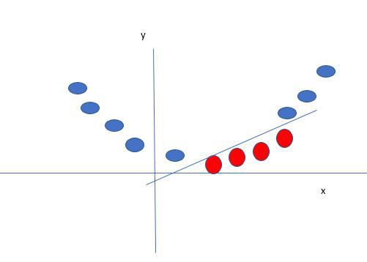
SVM solves this by creating a new variable using a kernel.
A non-linear function that creates a new variable is referred to as kernel.

Slide 18
SVM Kernel
The SVM kernel is a function that takes low dimensional input space and transforms it into higher-dimensional space.
It converts not separable problem to separable problem. It is mostly useful in non-linear separation problems.
Simply put the kernel, it does some extremely complex data transformations then finds out the process to separate the data based on the labels or outputs defined.

Slide 19
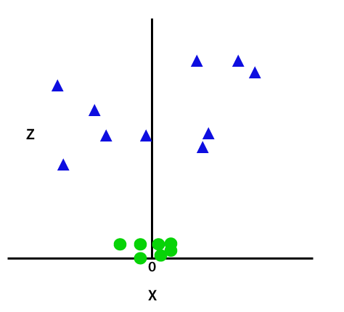
we need to add one more dimension.
z=x^2 + y^2
Sample Space after adding third dimension

Slide 20
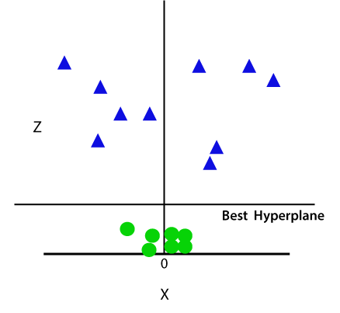
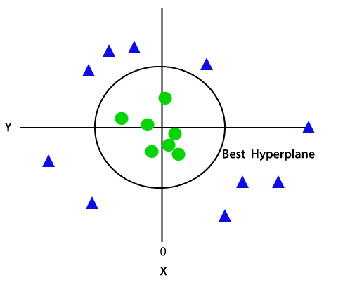

Slide 21
Kernel Functions
Linear
Polynomial
Radial Basis Function (RBF)
Sigmoid
More useful in neural networks than in support vector machines, but there are occasional specific use cases.

Slide 22
Steps for Data Preprocessing
Getting the dataset
Importing libraries
Importing datasets
Finding Missing Data
Encoding Categorical Data
Splitting dataset into training and test set
Feature scaling

Slide 23
Steps
Getting the dataset: CSV Files
Importing Libraries
Import pandas as pd
is one of the most famous Python libraries and used for importing and managing the datasets. It is an open-source data manipulation and analysis library
import matplotlib as mp
Python 2D plotting library, and with this library, we need to import a sub-library pyplot. This library is used to plot any type of charts in Python for the code.
import numpy as nm
Numpy Python library is used for including any type of mathematical operation in the code. It is the fundamental package for scientific calculation in Python. It also supports to add large, multidimensional arrays and matrices

Slide 24
Importing the Datasets
data_set= pd.read_csv('Dataset.csv’)
data_set.head()
data_set.tail()
data_set.shape()
data_set[‘class’].value_counts()

Slide 25
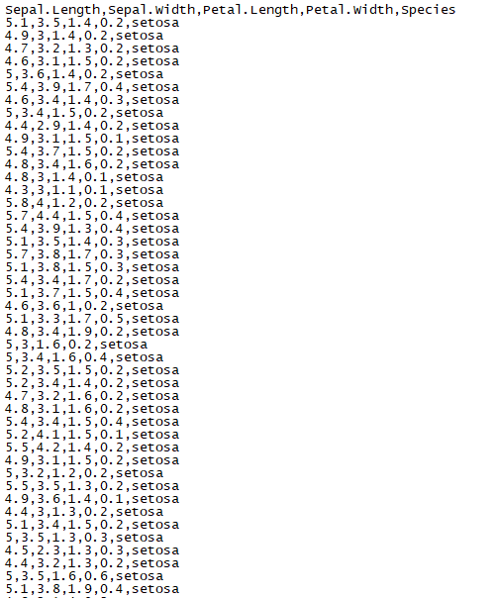

Slide 26
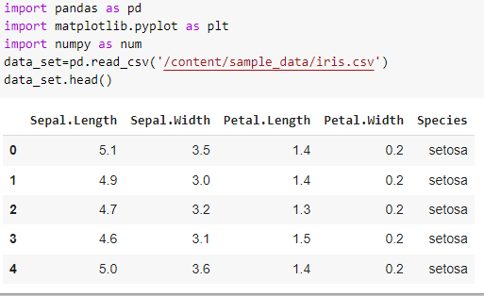
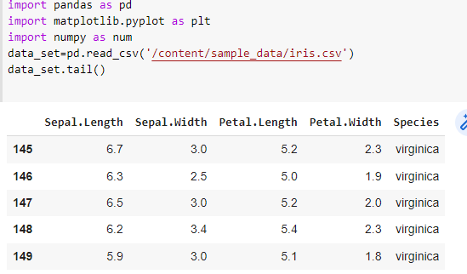

Slide 27
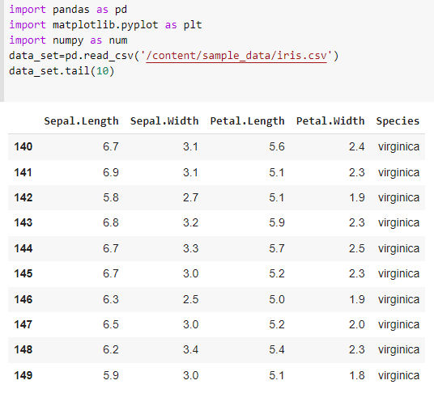
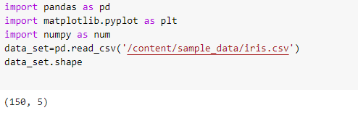
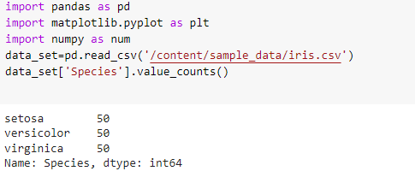

Slide 28
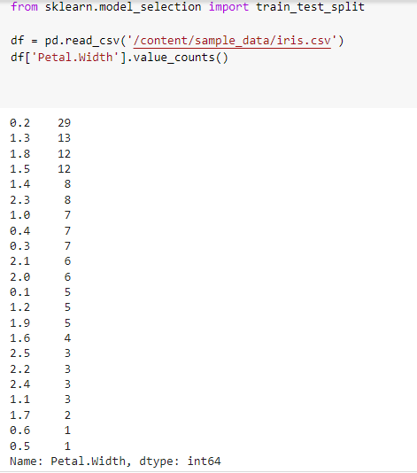

Slide 29
Extracting dependent and independent variables:
To extract an independent variable, we will use iloc[ ] method of Pandas library.
It enables us to select a particular cell of the dataset, that is, it helps us select a value that belongs to a particular row or column from a set of values of a data frame or dataset.
It is used to extract the required rows and columns from the dataset.
x= data_set.iloc[:,:-1].values
In the above code, the first colon(:) is used to take all the rows, and the second colon(:) is for all the columns. Here we have used :-1, because we don't want to take the last column as it contains the dependent variable. So by doing this, we will get the matrix of features.

Slide 30
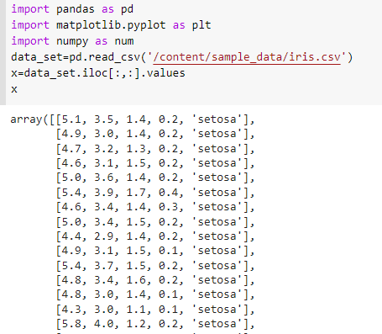
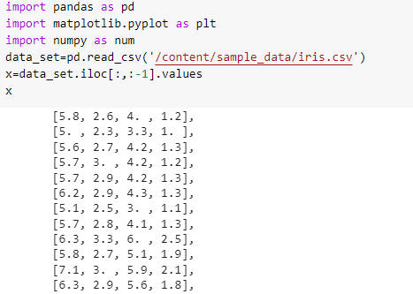

Slide 31
Extracting dependent variable:
To extract dependent variables, we will use Pandas .iloc[] method.
y= data_set.iloc[:,3].values
Here we have taken all the rows with the last column only. It will give the array of dependent variables.

Slide 32
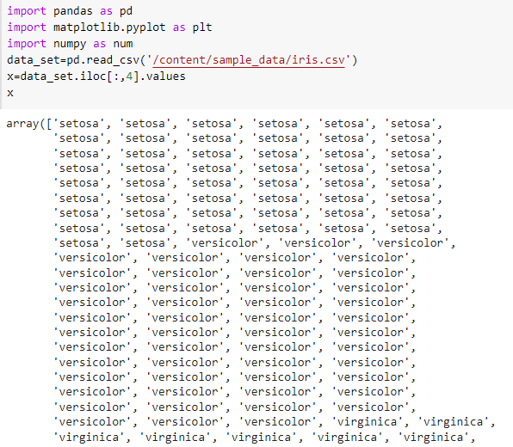

Slide 33
Handling Missing data:
By deleting the particular row: The first way is used to commonly deal with null values. In this way, we just delete the specific row or column which consists of null values.
By calculating the mean: In this way, we will calculate the mean of that column or row which contains any missing value and will put it on the place of missing value.
Another method is ‘most frequent’

Slide 34
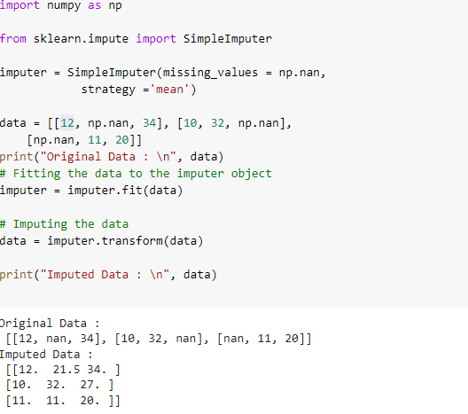

Slide 35
Encoding Categorical Data
What is categorical data?
Categorical variables are usually represented as ‘strings’ or ‘categories’ and are finite in number.
The city where a person lives: Delhi, Mumbai, Ahmedabad, Bangalore, etc.
The department a person works in: Finance, Human resources, IT, Production.
The highest degree a person has: High school, Diploma, Bachelors, Masters, PhD.
The grades of a student: A+, A, B+, B, B- etc.
There are two kinds of categorical data-
Ordinal Data: The categories have an inherent order
Nominal Data: The categories do not have an inherent order

Slide 36
In Ordinal data, while encoding, one should retain the information regarding the order in which the category is provided. Like in the above example the highest degree a person possesses, gives vital information about his qualification.
While encoding Nominal data, we have to consider the presence or absence of a feature. In such a case, no notion of order is present. For example, the city a person lives in.
One Hot Encoding
from sklearn.preprocessing import LabelEncoder, OneHotEncoder

Slide 37
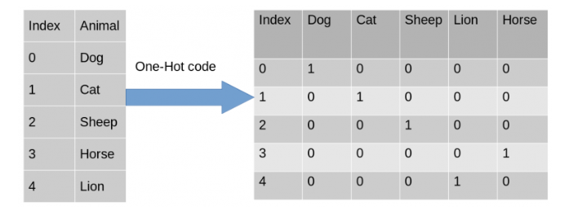

Slide 38
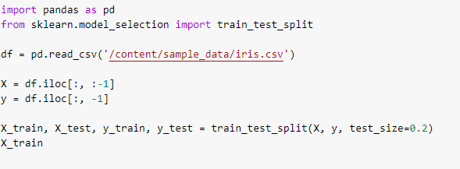
Splitting dataset into training and test set
train_test_split() function.
The function takes a loaded dataset as input and returns the dataset split into two subsets.

Slide 39
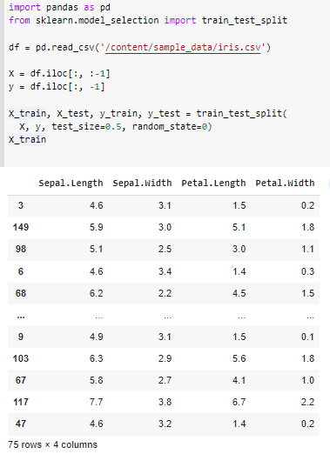
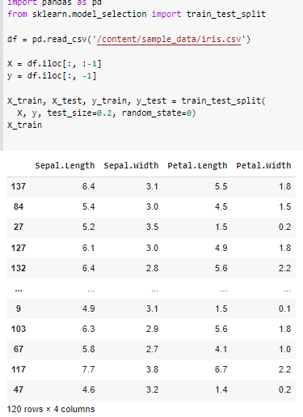

Slide 40
Feature Scaling
Feature Scaling is a technique to standardize the independent features present in the data in a fixed range.
It is performed during the data pre-processing to handle highly varying magnitudes or values or units.
If feature scaling is not done, then a machine learning algorithm tends to weigh greater values, higher and consider smaller values as the lower values, regardless of the unit of the values.
We use Feature Scaling to bring all values to the same magnitudes and thus, tackle this issue. we put our variables in the same range and in the same scale so that no any variable dominate the other variable.

Slide 41
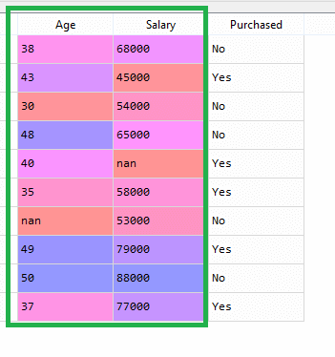
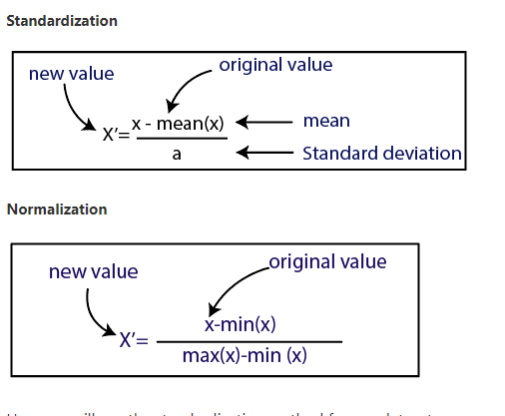
As we can see, the age and salary column values are not on the same scale. A machine learning model is based on Euclidean distance.
If we compute any two values from age and salary, then salary values will dominate the age values, and it will produce an incorrect result. So to remove this issue, we need to perform feature scaling for machine learning.

Slide 42
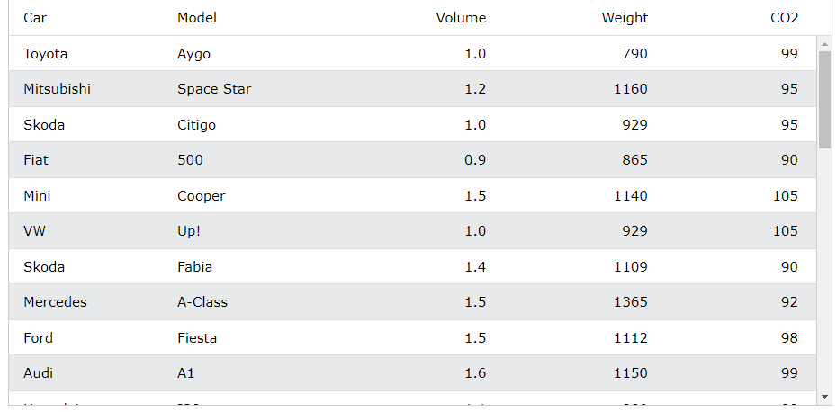
(790 - 1292.23) / 238.74 = -2.1
(1.0 - 1.61) / 0.38 = -1.59
Feature Scaling on Weight
Feature Scaling on Volume

Slide 43
